Slide 1
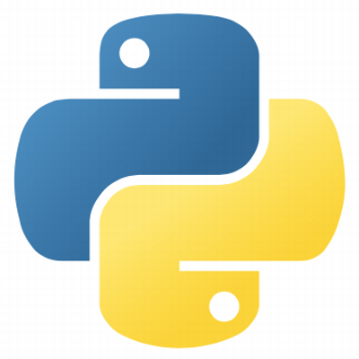

Python
for
Machine Learning
Copyright © www.ITbodhi.com

Slide 2

Python
Python is a high-level, interpreted, interactive and object-oriented scripting language.
Python is designed to be highly readable.
It uses English keywords frequently where as other languages use punctuation, and it has fewer syntactical constructions than other languages.
Copyright © www.ITbodhi.com

Slide 3
Python libraries for Machine Learning
NumPy: Numpy is one of the greatest Mathematical and Scientific computing library for Python. Tensorflow and other platforms use Numpy internally for performing several operations on Tensors.
SciPy: SciPy is a library of software for engineering and science. SciPy contains modules for linear algebra, optimization, integration, and statistics. The main functionality of SciPy library is built upon NumPy.
Pandas: Pandas is a Python package designed to do work with “labeled” and “relational” data simple and intuitive. Pandas is a perfect tool for data wrangling. It designed for quick and easy data manipulation, aggregation, and visualization.
Matplotlib: Python Library that is tailored for the generation of simple and powerful visualizations Examples: Line plots; Scatter plots; Bar charts and Histograms; Pie charts; Stem plots; Contour plots;
Copyright © www.ITbodhi.com

Slide 4
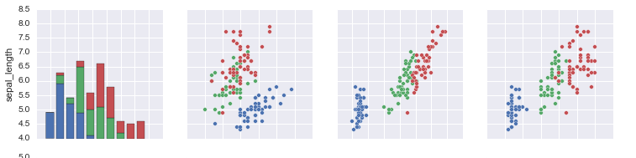
Python libraries for ML
Seaborn: Seaborn is mostly focused on the visualization of statistical models; such visualizations include heat maps, those that summarize the data but still depict the overall distributions. Seaborn is based on Matplotlib.
SciKit-Learn: Scikits are additional packages of SciPy Stack designed for specific functionalities like image processing and machine learning facilitation. The scikit-learn exposes a concise and consistent interface to the common machine learning algorithms, making it simple to bring ML into production systems.
Copyright © www.ITbodhi.com

Slide 5
Python libraries for Deep Learning
Theano: Theano is a Python package that defines multi-dimensional arrays similar to NumPy, along with math operations and expressions. The library is compiled, making it run efficiently on all architectures. Originally developed by the Machine Learning group of Université de Montréal, it is primarily used for the needs of Machine Learning..
TensorFlow: Coming from developers at Google, it is an open-source library of data flow graphs computations, which are sharpened for Machine Learning. It was designed to meet the high-demand requirements of Google environment for training Neural Networks.
Keras: It is an open-source library for building Neural Networks at a high-level of the interface, and it is written in Python. It is minimalistic and straightforward with high-level of extensibility. It uses Theano or TensorFlow as its backends, but Microsoft makes its efforts now to integrate CNTK (Microsoft’s Cognitive Toolkit) as a new back-end.
Keras is really eased to get started with and keep going with quick prototyping. It is written in pure Python and high-level in its nature. It is highly modular and extendable.
Copyright © www.ITbodhi.com

Slide 6
Python libraries for Natural Language Processing
NLTK: Natural Language Toolkit The functionality of NLTK allows a lot of operations such as text tagging, classification, and tokenizing, name entities identification, building corpus tree that reveals inter and intra-sentence dependencies, stemming, semantic reasoning.
ScrapyScrapy is a library for making crawling programs, also known as spider bots, for retrieval of the structured data, such as contact info or URLs, from the web.
It is open-source and written in Python. It was originally designed strictly for scraping, as its name indicate, but it has evolved in the full-fledged framework with the ability to gather data from APIs and act as general-purpose crawlers.
XGBoost : XGBoost is an optimized distributed gradient boosting library designed to be highly efficient, flexible and portable. It implements machine learning algorithms under the Gradient Boosting framework. XGBoost provides a parallel tree boosting (also known as GBDT, GBM) that solve many data science problems in a fast and accurate way. .
Copyright © www.ITbodhi.com

